Slide 1
LogPress: Optimized Compression and Retrieval of Unstructured Logs
Neel Dudheliya
Tanay Gandhi
Pranav Jibhakate
Notes:
Good afternoon, everyone. I’m Pranav, and I’m here with Neel Dudheliya and Tanay. Today, we’re excited to present our project — “LogPress: Optimized Compression and Retrieval of Unstructured Logs.” We’ve focused on making log storage and retrieval more efficient, especially in high-volume environments.
Let’s get started.

Slide 2
Best Presentation: SPHERE
POV: Me and the boys taking notes
Notes:
Last time, SPHERE set the bar high with their presentation, so we’ve stepped up and added our own to keep things just as engaging.

Slide 3
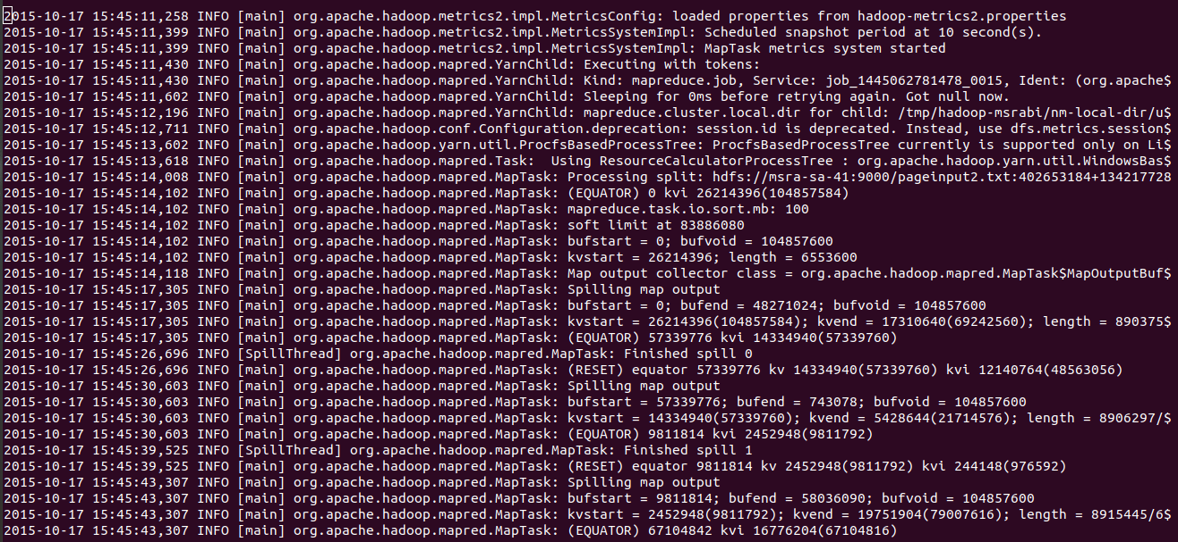
The Problem
Notes:
Here’s a sample of the kind of log data we’re dealing with. As you can see, logs are verbose, repetitive, and largely unstructured.
You'll notice patterns: repeated timestamps, log levels like "INFO", and recurring class names. These repetitions contribute significantly to storage overhead.
And the real issue? To search anything in this after compression, we’re forced to decompress the entire file — just for a small piece of information. That’s inefficient… and honestly, it’s trash.

Slide 4
Solution
Logpress
Instead of storing each line in full, we can detect repeated patterns, abstract variable values, and only store essentials.
This leads to significant space saving and faster searching in compressed form.
Notes:
To address these issues, we built LogPress.
Instead of storing every log line in its entirety, we identify and extract common patterns, extract out variable parts, and store only what’s essential.
This approach drastically reduces storage requirements and, more importantly, enables fast searching without needing full decompression.

Slide 5
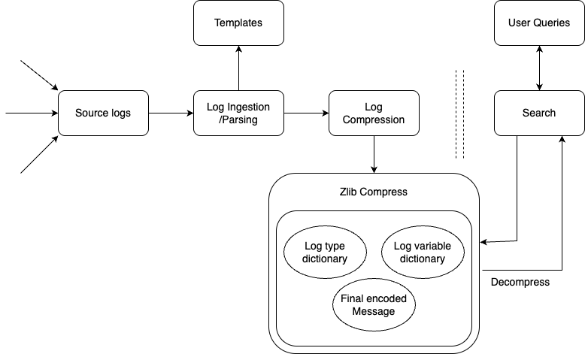
Components
Notes:
Here’s an overview of LogPress’s architecture.
We begin with source logs (log file or log directories), which go through ingestion and parsing to extract templates.
Then comes compression, where we use template type and variable dictionaries along with Zlib.
On the retrieval side, user queries are handled through a search module with partial decompression.

Slide 6
Template & Variable Extraction
Original Log
Template
Variables
User 99 logged in at 123500
Notes:
- Thanks Pranav, now let's look into how compression works in our algorithm
- The first step to compression is creating templates and extracting variables.
- Here we have an example log that we can go trough step by step

Slide 7
Template & Variable Extraction
Original Log
Template
Variables
User 99 logged in at 123500
IDs | Template
1 | User <VAR> logged in at <VAR>
n | …..
User <VAR> logged in at <VAR>
Notes:
- Firstly, we will extract the number tokens from the logs using regex-based parser.
- The resulting log line will work as a template and will be stored in a dictionary with ID 1
- If in the future we encounter logs with the same template we can utilize the ID from the dictionary and reduce redundancy.

Slide 8
Template & Variable Extraction
Original Log
Template
Variables
User 99 logged in at 123500
IDs | Templates
1 | User <VAR> logged in at <VAR>
n | …..
User <VAR> logged in at <VAR>
IDs | Variables
1 | 99
2 | 123500
n | …..
[“99”, “123500”]
Resulting Entry: {1, [1, 2] }
Notes:
- The extracted variables from the previous step are extracted and store in a global variable dictionary.
- After we have updated the template and variable dictionary, we substitute the original log line with the Resulting Entry which contains the template id 1 and ordered variable ids with 1 and 2.
Decompress:
- Once we have the entries from chunk and the global dictionaries from archive header we can substitute the values to get the original logs.
- Later we write the original logs to their respective files and restore the logs.

Slide 9
Chunking Step
Chunk 1
“TMPL”
Entry 1
Uncompressed Size
and so on…
File Name/ID
Entry 2
Currently we are doing a fixed chunk size of 5000 lines of log.
Notes:
- Next step, would be the chunking step.
- Here we are dividing the log files in a fixed chunk size of 5000 log lines
- Each chunk will have a header mentioning some metadata and checksum for that chunk and the body will have encoded entries of all 5000 logs.
- "TMPL" is added as a general text that is used for validation during the decompression step. File Name determines which file does this chunk belong to and the uncompressed size is used as a checksum for the decompress step.
Decompression: - Next we will decompress each chunk one by one with the similar logic and get all the encoded entries.

Slide 10

General Compressing
Chunk 1
“TMPL”
Entry 1
Uncompressed Size
and so on…
File Name/ID
Entry 2
Zlib Compression
Notes:
- To reduce further repetition, we perform a zlib general compression on that chunk.
- The meme here is just to keep you guys engaged in the presentation.

Slide 11
General Compressing
Chunk 1
“TMPL”
Entry 1
Uncompressed Size
and so on…
File Name/ID
Entry 2
Zlib Compression
Chunk n
“TMPL”
Entry 1
Uncompressed Size
and so on…
File Name/ID
Entry 2
Zlib Compression
Notes:
- We do the general compression step for all the chunks from the log file.

Slide 12
General Compressing
Global Headers with ”TMZL”, uncompressed size and dictionaries
Chunk 1
“TMPL”
Entry 1
Uncompressed Size
and so on…
File Name/ID
Entry 2
Zlib Compression
“TMPL”
Entry 1
Uncompressed Size
and so on…
File Name/ID
Entry 2
Chunk n
Zlib Compression
Notes:
- Finally, we add global header for adding more metadata regarding the compressed file.
- A general text "TMZL" similar to the "TMPL" used for validation before decompression. Uncompressed size for checksum.
- The global template and variable dictionaries are then compressed again to finally generate a binary format archive file.
Decompress:
- We will first validate using the "TMZL" to make sure the compression algorithm used is ours. Then we will decompress the global headers with the zlib decompressor to get the global dictionaries.

Slide 13
Decompression
Validate Archive: Check the global header to confirm the file format.
Initialize Dictionaries: Use zlib to decompress the global template and variable dictionaries.
Chunk-Based Decompression: Process each chunk, substituting the original values back into the logs using the dictionaries.
File Reconstruction: Write each decompressed log line to the appropriate file based on its file ID, restoring the original content.
Notes:
- Now, lets explore how decompression works.
- The steps to decompress will include validating the arhive. Initializing the global dictionaries and then decompressing chunk by chunk and final step of reconstruting the log file.
- Now how do we do all this....

Slide 14
Decompression
Validate Archive: Check the global header to confirm the file format.
Initialize Dictionaries: Use zlib to decompress the global template and variable dictionaries.
Chunk-Based Decompression: Process each chunk, substituting the original values back into the logs using the dictionaries.
File Reconstruction: Write each decompressed log line to the appropriate file based on its file ID, restoring the original content.
Notes:
- We just play UNO reverse !!! Just kidding but it works similar to uno reverse.
-

Slide 15
Searching
Validate Archive: Read the global header to confirm the file format.
1
Initialize Dictionaries: Load templates and variable values from the decompressed global section.
2
Chunk-Based Processing: Decompress each chunk in turn to reconstruct log lines (using the template and variable dictionaries).
3
Match Search Term: Compare each reconstructed line with the query (supporting wildcards).
4
Report Results: Print all matching lines along with their corresponding filenames.
5
Notes:
- Searching shares some steps with decompression in that we validate the archive get the global dictionaries and do chunk based processing.
- We then take the user query which can be a static string based search or a wildcard query (will be explained later). The results are then printed back to user.

Slide 16
Searching chunk by chunk
Wildcard Query: “ERROR * Container ???”
Chunk 1
“TMPL”
Entry 1
Uncompressed Size
and so on…
File Name/ID
Entry 2
Search for log
Chunk n
“TMPL”
Entry 1
Uncompressed Size
and so on…
File Name/ID
Entry 2
Lazy search to the last chunk
Notes:
- Let's look at how we do search without complete decompression of the archive file.
- We have an example of wildcard query here on top.
- After the global decompression step, we will decompress it chunk by chunk. If we find the result in chunk 1 we print it and then carry on to the next chunk.
- This approach of lazy searching helps to get the results faster and utilizes less resources.

Slide 17
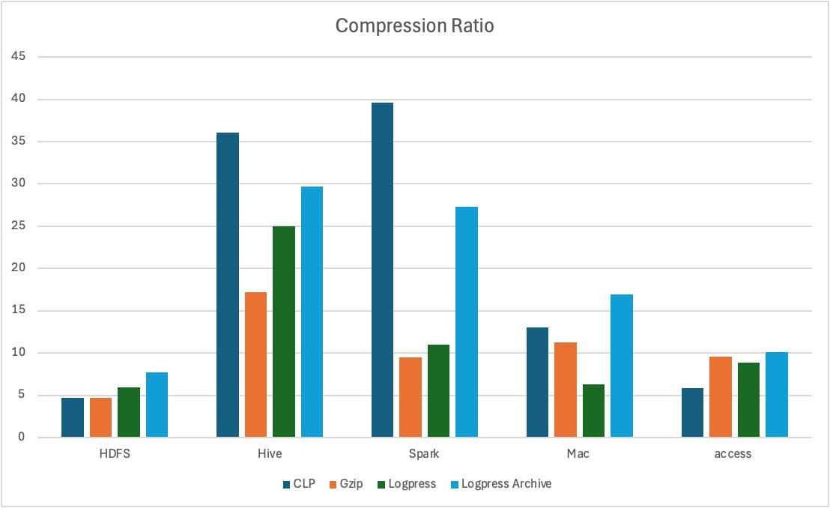
Results - Compression
Notes:
For results first we will consider the compression ratio. The compression ratio measures the ratio of the size of uncompressed logs to the size of compressed logs.
We’re comparing the compression performance of four algorithms: GZIP, CLP, Logpress, and Logpress Archive.
GZIP is a general compressor optimized for text, in our experiment GZIP’s size doesn’t include the index size, which is used for searching in tools like Splunk. So the bar chart of GZIP should be lower than displayed here.
while CLP is the only algorithm we found that supports searching without decompressing, so we’re considering it as well.
Logpress is the algorithm we’ve implemented, and Logpress Archive is another version of our algorithm that doesn’t support searching but can be used for cold storages.
The dataset includes: logs from various applications ranging in size from 15MB to 2GB.
In this graph, higher compression ratio is better.
Our algorithm performs well in most cases, except mac and access which is more textual logs
NOtably our algorithm outperforms the other 2 in case of HDFS
in terms of compression, LogPress archive outperforms Gzip in all datasets
next metric we consider is the search time on compressed logs

Slide 18
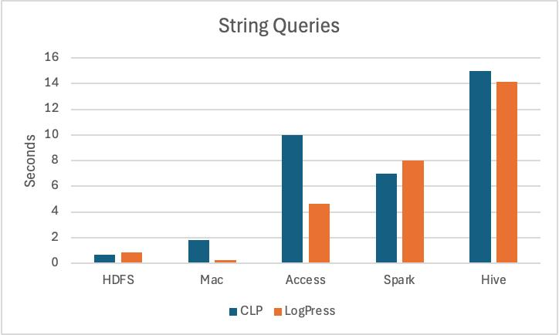
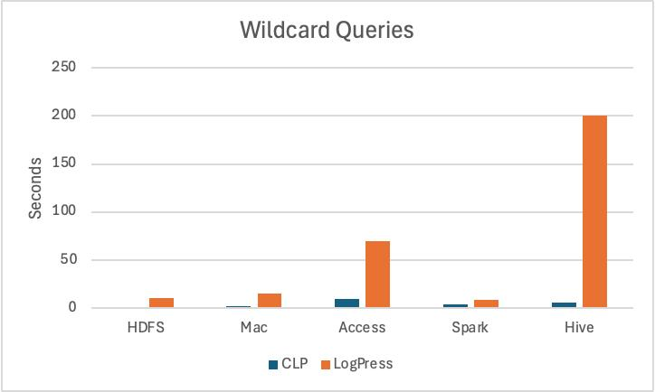
Results – Search speed
Notes:
A lower bar is better in this case as it indicates a faster search time
The left graph shows the search times of static strings. In this graph, CLP and Logpress perform almost the same, and in some cases, LogPress even outperforms CLP in dataset like access, Hive and Mac.
The right graph shows times with queries that include wildcard entries. Logpress is significantly slower than CLP as we recently added it and are actively working on optimizing it.

Slide 19



What’s Next?
Optimized Querying: Refine wildcard and regex handling to further improve performance in searching
Stream-Based Compression: Leverage chunk-based design to seamlessly support real-time, stream-based log compression for applications.
Scalability Enhancements: Explore distributed compression/decompression options for high-throughput environments.
Notes:
For future scope
We need to improve the performance of wildcard queries, so we’re working on that.
We’re also planning to implement stream-based compression. Since we’re already using chunking in our algorithm, we plan to extend that functionality to handle real-time logs.
We’re also exploring distributed compression and decompression for high-throughput environments.

Slide 20
Thank you

